Slide 2
Absence of Copyright
This slideshow contains photos, diagrams, and information, some of which were attained through internet searches of public websites. The author of this presentation does not own the copyright on this information, so this slideshow is for personal use only—not for sale or profit. Please utilize it to seek the Lord and grow in your knowledge of His Word and ways.
Bro Stan’s Revelation Study is available on our church website:
www.faithprinceton.org

Slide 4
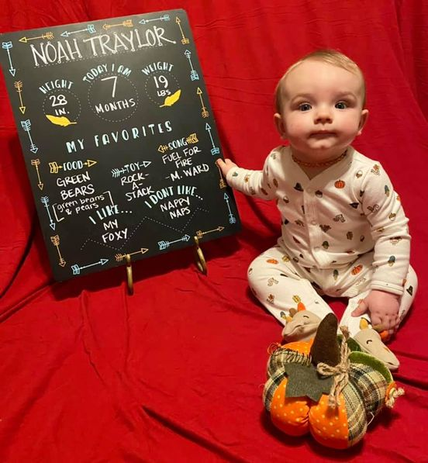
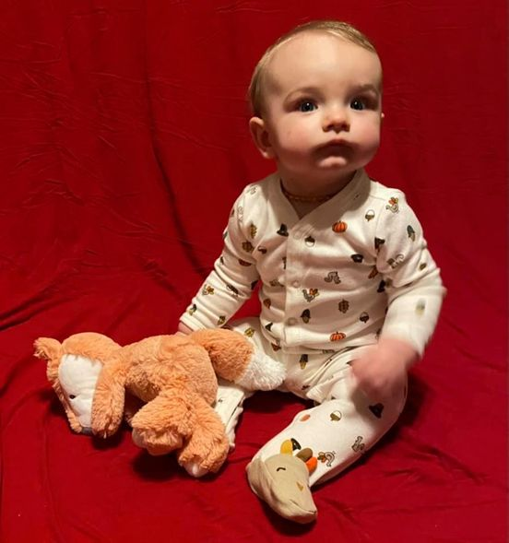
Noah is 7 months old!

Slide 5
Prayer and Announcements
Sundays Facebook Live or In-person:
9:15 Small Group Sunday School Classes
10:30 Worship
--------------------------------
Mask in and Mask out...

Slide 6
Prayer and Announcements
NO BIBLE STUDY NEXT WEDNESDAY!
ENJOY YOUR THANKSGIVING!!!

Slide 8
BEGIN HERE November 18, 2020
Week 26 – Revelation 18
The Fall of Babylon

Slide 9
Revelation 18 The Fall of Babylon
1 After these things I saw another angel coming down from heaven, having great authority, and the earth was illuminated from his glory. 2 And he cried out with a mighty voice, saying, “Fallen, fallen is Babylon the great! She has become a dwelling place of demons and a prison of every unclean spirit, and a prison of every unclean and hateful bird. 3 For all the nations have fallen because of the wine of the passion of her sexual immorality, and the kings of the earth have committed acts of sexual immorality with her, and the merchants of the earth have become rich from the excessive wealth of her luxury.”
Notes:
Angel announces and illuminates the earth with glory!!!
Morris
In describing the destruction of Babylon John describes God’s judgment of the great satanic system of evil that has corrupted the earth’s history. This vivid description draws especially from the Old Testament accounts of the destruction of the ancient harlot cities of Babylon (Isa. 13:21; 47:7-9; Jer. 50-51) and Tyre (Exek 26:17-21)... Beautifully expressive language... (Morris 276)
She has become a dwelling place of demons and a prison of every unclean spirit, and a prison of every unclean and hateful bird
Filled with Demonic Decadence and Desire ➔ sound like any nation that we know of???
ALL NATIONS fall because of immorality and excess!!!
Kings committing sexual immorality ➔ picture of moral depravity OR idolatry? Or both?
Excessive wealth of her luxury !!! America is land of plenty!!! Excessive ➔ more than one TV? Car? Set of clothing?

Slide 10
Revelation 18 The Doom of Babylon
4 I heard another voice from heaven, saying, “Come out of her, my people, so that you will not participate in her sins and receive any of her plagues; 5 for her sins have piled up as high as heaven, and God has remembered her offenses.
Notes:
God will warn His people!!! ➔ He already has!!! Read the Word!!!
Separate from them to not Share in their sins and face their fate
2 Corinthians 6
14 Do not be yoked together with unbelievers. For what do righteousness and wickedness have in common? Or what fellowship can light have with darkness? 15 What harmony is there between Christ and Belial? Or what does a believer have in common with an unbeliever? 16 What agreement is there between the temple of God and idols? For we are the temple of the living God. As God has said:
“I will live with them and walk among them, and I will be their God, and they will be my people.”
17 Therefore, “Come out from them and be separate, says the Lord. Touch no unclean thing, and I will receive you.” (Isaiah 52:11)
Sins as high as heaven??? (compare Jer 51:9; Ezra 9:6) Tower of Babel?
God remembers ➔ Although it looks as though the wicked go unpunished, John reminds his readers that “God remembers” and in His own time he will come with judgment. (Morris, 277)

Slide 11
Revelation 18 The Doom of Babylon
6 Pay her back even as she has paid, and give back to her double according to her deeds; in the cup which she has mixed, mix twice as much for her. 7 To the extent that she glorified herself and lived luxuriously, to the same extent give her torment and mourning; for she says in her heart, ‘I sit as a queen and I am not a widow, and will never see mourning.’ 8 For this reason in one day her plagues will come, plague and mourning and famine, and she will be burned up with fire; for the Lord God who judges her is strong.
Notes:
Babylon will receive exactly what it has earned and double what it has given!
6 Pay her back even as she has paid,
give back to her double according to her deeds;
in the cup which she has mixed, mix twice as much for her.
God made her drink her own poison!!!
7 To the extent that she glorified herself and lived luxuriously,
to the same extent give her torment and mourning
Romans 1:24-32 God’s wrath is already being revealed...
IN ONE DAY ➔ it will ALL happen very quickly!!!
burned up with fire; for the Lord God who judges her is strong.

Slide 12
Revelation 18 The Doom of Babylon
9 “And the kings of the earth, who committed acts of sexual immorality and lived luxuriously with her, will weep and mourn over her when they see the smoke of her burning, 10 standing at a distance because of the fear of her torment, saying, ‘Woe, woe, the great city, Babylon, the strong city! For in one hour your judgment has come.’
Notes:
SEE EZEKIEL 26-29 FOR BACKGROUND!!!
Lived luxuriously = Die in torment
Parable: Rich man and Lazarus
Eternity: opposite of the worldly stuff you treasured here???
Strong city... In one hour your judgment has come
Man’s strength is no match for God’s judgment, even when backed up by the beast!
Ezekiel 28 New International Version
A Prophecy Against the King of Tyre
28 The word of the Lord came to me: 2 “Son of man, say to the ruler of Tyre, ‘This is what the Sovereign Lord says:
“‘In the pride of your heart
you say, “I am a god;
I sit on the throne of a god
in the heart of the seas.”
But you are a mere mortal and not a god,
though you think you are as wise as a god.
3 Are you wiser than Daniel?
Is no secret hidden from you?
4 By your wisdom and understanding
you have gained wealth for yourself
and amassed gold and silver
in your treasuries.
5 By your great skill in trading
you have increased your wealth,
and because of your wealth
your heart has grown proud.
6 “‘Therefore this is what the Sovereign Lord says:
“‘Because you think you are wise,
as wise as a god,
7 I am going to bring foreigners against you,
the most ruthless of nations;
they will draw their swords against your beauty and wisdom
and pierce your shining splendor.
8 They will bring you down to the pit,
and you will die a violent death
in the heart of the seas.
9 Will you then say, “I am a god,”
in the presence of those who kill you?
You will be but a mortal, not a god,
in the hands of those who slay you.
10 You will die the death of the uncircumcised
at the hands of foreigners.
I have spoken, declares the Sovereign Lord.’”
11 The word of the Lord came to me: 12 “Son of man, take up a lament concerning the king of Tyre and say to him: ‘This is what the Sovereign Lord says:
“‘You were the seal of perfection,
full of wisdom and perfect in beauty.
13 You were in Eden,
the garden of God;
every precious stone adorned you:
carnelian, chrysolite and emerald,
topaz, onyx and jasper,
lapis lazuli, turquoise and beryl.
Your settings and mountings were made of gold;
on the day you were created they were prepared.
14 You were anointed as a guardian cherub,
for so I ordained you.
You were on the holy mount of God;
you walked among the fiery stones.
15 You were blameless in your ways
from the day you were created
till wickedness was found in you.
16 Through your widespread trade
you were filled with violence,
and you sinned.
So I drove you in disgrace from the mount of God,
and I expelled you, guardian cherub,
from among the fiery stones.
17 Your heart became proud
on account of your beauty,
and you corrupted your wisdom
because of your splendor.
So I threw you to the earth;
I made a spectacle of you before kings.
18 By your many sins and dishonest trade
you have desecrated your sanctuaries.
So I made a fire come out from you,
and it consumed you,
and I reduced you to ashes on the ground
in the sight of all who were watching.
19 All the nations who knew you
are appalled at you;
you have come to a horrible end
and will be no more.’”

Slide 13
Revelation 18 The Doom of Babylon
11 “And the merchants of the earth weep and mourn over her, because no one buys their cargo any more— 12 cargo of gold, silver, precious stones, and pearls; fine linen, purple, silk, and scarlet; every kind of citron wood, every article of ivory, and every article made from very valuable wood, bronze, iron, and marble; 13 cinnamon, spice, incense, perfume, frankincense, wine, olive oil, fine flour, wheat, cattle, sheep, and cargo of horses, carriages, slaves, and human lives.
Notes:
Extensive list of CARGO vs. 11-13
V 13 slaves and human lives... Servants and entertainment/devalued humanity (the Coliseum, thrown to lions, etc.)
A vast market for slavery in the End Times?
Slavery is still allowed in over half the countries of the world!!!
worldpopulationreview.com says that today, 167 countries still have slavery, affecting about 46 million people
India (18.4 million)
China (3.4 million)
Pakistan (2.1 million)
Bangladesh (1.5 million)
Uzbekistan (1.2 million)
North Korea (1.1 million)

Slide 14
Revelation 18 The Doom of Babylon
14 The fruit you long for has left you, and all things that were luxurious and splendid have passed away from you and people will no longer find them. 15 The merchants of these things, who became rich from her, will stand at a distance because of the fear of her torment, weeping and mourning, 16 saying, ‘Woe, woe, the great city, she who was clothed in fine linen and purple and scarlet, and adorned with gold, precious stones, and pearls; 17 for in one hour such great wealth has been laid waste...
Notes:
All luxurious and splendid things gone... Passed away... No longer found...
Merchants weep and mourn over loss
IN ONE HOUR !!! Happens very quickly!!!

Slide 15
Revelation 18 The Doom of Babylon
...17 for in one hour such great wealth has been laid waste!’ And every shipmaster and every passenger and sailor, and all who make their living by the sea, stood at a distance, 18 and were crying out as they saw the smoke of her burning, saying, ‘What city is like the great city?’ 19 And they threw dust on their heads and were crying out, weeping and mourning, saying, ‘Woe, woe, the great city, in which all who had ships at sea became rich from her prosperity, for in one hour she has been laid waste!’
Notes:
IN ONE HOUR LAID WASTE!!!
Merchants weep

Slide 16
Revelation 18 The Doom of Babylon
20 Rejoice over her, O heaven, and you saints and apostles and prophets, because God has pronounced judgment for you against her.”
Notes:
CONTRAST:
merchants and sailors weep
Heaven rejoices
Saints and apostles and prophets
Because God has pronounced judgment
FOR YOU
AGAINST HER

